Slide 1
Research Presentation By: Muhammad Imran

Slide 2
Research Topic
Develop and test a GIS technique and tool for depth mapping and translation to consequences using remote sensing data
Flood inundation map
Flood water depth estimation
Linking depth with damages using depth damage functions
Determine consequences based
Why
Pakistan is affected by floods on a frequent basis so it is important to estimate consequences for identifying the recovery period
Notes:
Why;
Flood situation changes each year and have a severe impact on population and economy
So better understanding of consequences will help to divert the investment where it is required the most
SDG 6
Food security

Slide 3
Problem Statement
Pakistan is affected by floods on a frequent basis so it is important to estimate consequences for identifying the recovery period

Slide 4
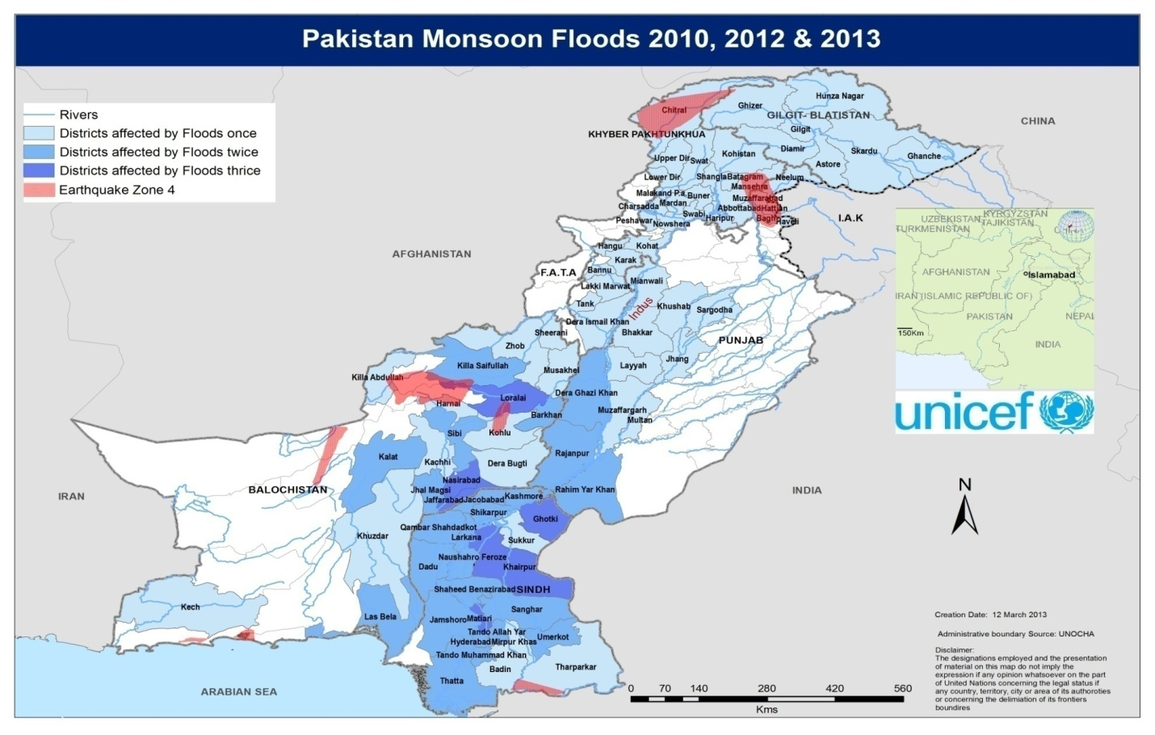
Background of Floods in Pakistan
Riverine and flash floods
Riverine floods due to snow/glacier melting and monsoon (June-Aug) rainfall and will be considered in the study
Main affected areas lies on the banks of Indus and Chenab
Most affected areas
Southern Punjab
Northern Sindh
Study Area selected for the implementation of framework is Rajanpur – Punjab
Notes:
Floods in Rajanpur
2010
2012
2014

Slide 5
Deaths

Slide 6
Damage to Houses

Slide 7
Access to Clean Water

Slide 8
Water and Agriculture Situation in Study Area
Water Infrastructure
Municipal water supply through tube wells
Individual hand pumps
Crops
Cotton
Sugar cane
Wheat

Slide 9
Previous Studies
Pakistan Flood Impact Assessment, 2010, World Food Program
Market situation
Livelihood and Assets
Food Security
Kirsch, Thomas D., et al. "Impact of the 2010 Pakistan floods on rural and urban populations at six months." PLoS currents 4 (2012).
Focused primarily on WASH aspect pre and post flood conditions
Preliminary Damage Estimates for Pakistan Flood Events, 2010, Ball State University
Flood Damage Modeling on the Basis of Urban Structure Mapping Using High Resolution Remote Sensing – Tina G et. Al
Impact of the 2010 Pakistan Floods on Rural and Urban Population at Six Months – (Kirsch TD 2012)
National Disaster Management Reports (2010, 2011)
Damage data aggregated

Slide 10
Research Objective

Slide 11
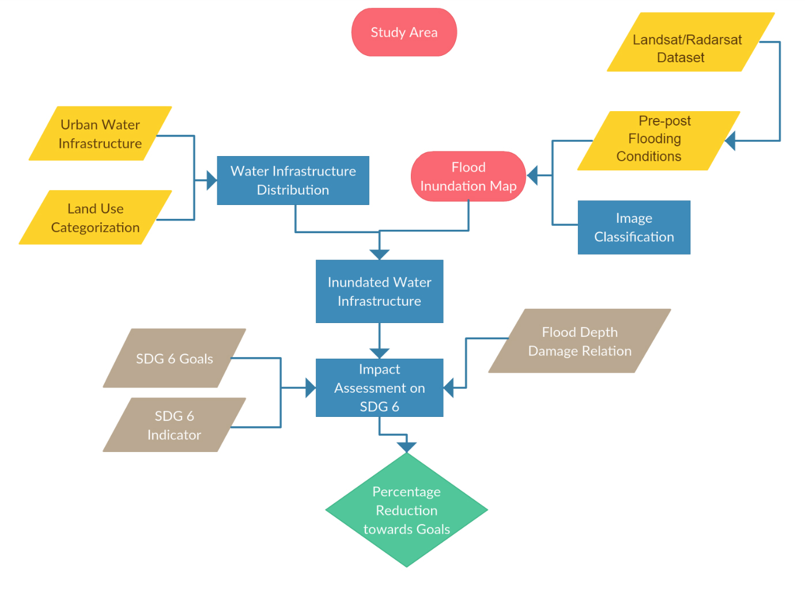
Methodology

Slide 12
Data Required
Digital Elevation Model
30m resolution data (USGS-LPDACC) will be resampled to 15m resolution
SAR – Optical Imagery
Pre and post flood event
Land Use Map
District level damages to buildings, water infrastructure or agriculture
Damage function for buildings, urban water infrastructure and agriculture crops a way to quantify consequences

Slide 13
Next Steps
Damage data collection sector wise
Flood inundation mapping
Water depth estimation
Damage function development
Consequences assessment
Notes:
Results:
SDG 6 matrix development and reduction in SDG target
Urban water infrastructure depth damage function development and estimation

